Slide 1

ETHICAL AI-DRIVEN LOAN DECISION SUPPORT SYSTEM FOR NBFC

Slide 2
Problem Statement Explanation
A mid-sized NBFC is facing the following challenges:
a) High Loan Processing Time
Manual verification, document checks, and branch-level approvals slow down loan sanctioning, leading to poor customer experience and loss of business.
b) Inconsistent Credit Decisions Across Branches
Different branches follow different judgment standards, causing unfair approvals/rejections and lack of standardization.
c) Rising NPAs in MSME Loans
Improper risk assessment, over-reliance on human judgment, and lack of predictive analytics lead to higher defaults.
d) Regulatory Scrutiny on AI Decisions
Regulators (RBI) demand transparent, explainable, and unbiased decision-making systems. Black-box AI models create compliance risk.

Slide 3
Objective of the System: Design an Ethical AI-Driven Loan Decision Support System
A. Transaction Processing System (TPS)
Purpose: Automates and records day-to-day loan transactions.
Outcome: Faster processing & error-free data collection
B. Management Information System (MIS)
Purpose: Converts TPS data into decision-support reports.
📌 Outcome: Helps managers monitor risk and standardize decisions
C. Machine Learning Risk Prediction System
Purpose: Predict probability of default (credit risk).
📌 Ethical Choice: Prefer interpretable models over black-box models

Slide 4
D. Rule-Based Expert Judgment System
Purpose: Apply human expertise & regulatory logic.
📌 Outcome: Combines AI intelligence with human wisdom.
E. Ethical & Compliance Layer
Ensures:
Fairness: No bias based on gender, caste, region
Transparency: Explainable reasons for approval/rejection
Accountability: Decision logs for audit
Regulatory Compliance: RBI, Fair Lending norms

Slide 5
Cost Estimation to Implement the System (Approx.)
COMPONENTS | Estimated Cost (₹)
AI/ML DEVELOPMENT | 8–12 lakhs
SOFTWARE INTEGRATION(TPS+MIS) | 8–8 lakhs
CLOUD INFRASTRUCTURE | 3–5 lakhs
COMPLIANCE & TESTING | 2-3 lakhs
TOTAL ESTIMATION COST | 18-28 lakhs

Slide 6
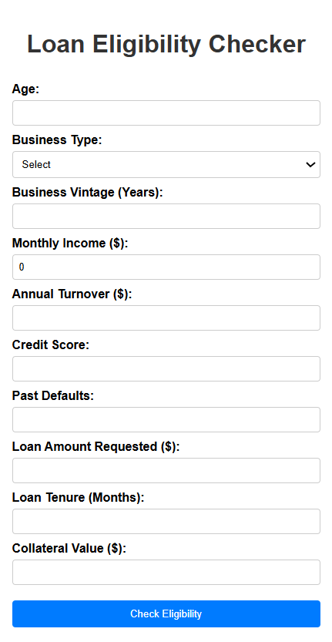
Variables of LOAN ELIGIBILITY CHECKER
AI TOOLS:
Front End: Java, HDML, CSS
Back End: Java Script
Variables:
Age, business type, vintage year, monthly income, yearly turnover, credit score, defaults, loan amount, tenure, collateral, ML risk, risk score.

Slide 7
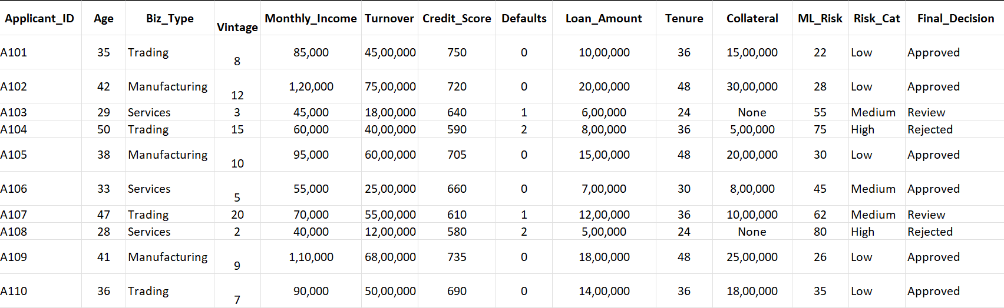

Slide 8
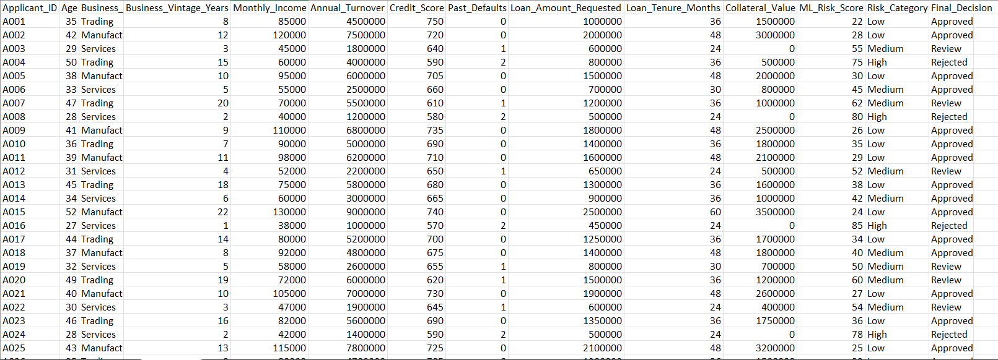

Slide 9
Ethical AI–Driven Loan Eligibility System Rule-Based Risk Assessment Framework
This document describes the rule-based logic used in the AI-driven Loan Decision Support System. The system calculates a Risk Score based on applicant profile, business characteristics, financial stability, and collateral security. Based on the computed score, the system determines the Risk Category, Final Decision, and Eligibility Status.
The base risk score starts at:
Initial Risk Score = 50
The score is then adjusted using the following objective rules.

Slide 10
RULES BASED EXPERT SYSTEM
Rule 1: Age Risk Rule
If applicant age is below 21 years or above 65 years, → Add 15 points to risk score.
Reason: Higher default probability outside productive age group.
Rule 2: Business Type Risk Rule
If Business Type = Startup, → Add 10 points
If Business Type = Service, → Add 5 points
Reason: Startups and service sectors carry moderate to higher risk compared to established trading/manufacturing.
Rule 3: Business Vintage Rule
If Business Vintage < 2 years → Add 15 points
If Business Vintage ≥ 5 years → Subtract 10 points
Reason: Experienced businesses are more stable and less risky.
Rule 4: Credit Score Rule
If Credit Score ≥ 750 → Subtract 20 points
If Credit Score ≥ 650 and < 750 → Subtract 10 points
If Credit Score < 650 → Add 20 points
Reason: Credit score is the strongest predictor of repayment behavior.

Slide 11
RULES BASED EXPERT SYSTEM
Rule 5: Default History Rule
If Past Defaults = 1 → Add 10 points
If Past Defaults > 1 → Add 25 points
Reason: Past behavior strongly influences future repayment probability.
Rule 6: EMI Burden Rule (Affordability Check)
If Monthly EMI (Loan Amount ÷ Tenure) > 40% of Monthly Income → Add 15 points
Reason: High EMI burden increases risk of default.
Rule 7: Collateral Coverage Rule
If Collateral Value ≥ Loan Amount → Subtract 10 points
If Collateral Value < 50% of Loan Amount → Add 15 points
Reason: Higher collateral reduces financial risk to NBFC.
3. Risk Categorization Logic
After applying all rules, the final Risk Score is categorized as:
Risk Score ≤ 40 → Low Risk
Risk Score between 41–70 → Medium Risk
Risk Score > 70 → High Risk

Slide 12
4. Decision-Making Rules
Based on Risk Category:
Risk Category Final Decision
Low- Approved →“Congratulations! Your loan is approved.”
Medium- Manual Review →“Your application requires manual verification.”
High- Rejected →“Your loan application is rejected due to high risk.”
5. Eligibility Status Rule
If Final Decision = Rejected → Status = Not Eligible
Otherwise → Status = Eligible

Slide 13
EXPECTED BENEFITS
LOAN PROCESSING TIME : Reduced by 40-60%
NPA( NON-PERFORMING ASSETS )REDUCTION : Reduced by 15-20%
CONSISTENT DECISION ACROSS BRANCHES
BETTER REGULATORY COMPLIANCE
IMPROVED CUSTOMER TRUST

Slide 14
RECOMMENDTIONS FOR LOAN PROCESSING
If the vintage year is more than 10 years, if the credit score is low and your collateral value is more than 50%, then the candidate is approved for the loan.
Use of e-KYC&API Integration for verification of and individual.

Slide 15
THANK YOU

